Slide 1
Software Engineering for Geoinformatics
June 2020

Slide 2

HATUA Web Application
Group (5):
Abubakr Albasheir
Faris Elsmani
MohammedELMustafe Eid
Wafi Mahdi
Politecnico di Milano
June 2020

Slide 3
About the Web Project:
HATUA is an initiative which seeks to address the global antibacterial resistance (ABR) crisis through local action.
It Spans several countries.
It is mostly concerned about:
● the pathogen.
● the patient.
● the community with the disease.
● The therapy landscape.

Slide 4
About the Web Application:
The Web application was created to allow users to visualize data from the HATUA field data.
The field data was extracted from https://five.epicollect.net/ which is an opensource data hub.

Slide 5
Steps of creating The Web Application:
Requirements Analysis and Specifications Document.
Goals
Domain Analysis
Relevant Phenomena
Use Cases
Requirements

Slide 6
Steps of creating The Web Application:
Design Document:
Modules
HTML Templates
Application Functions
Database
Test Plan
Software Interface

Slide 7
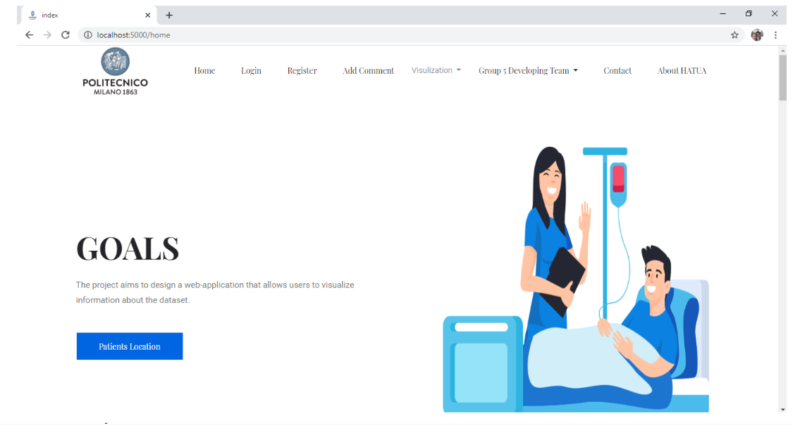
The Home Page

Slide 8
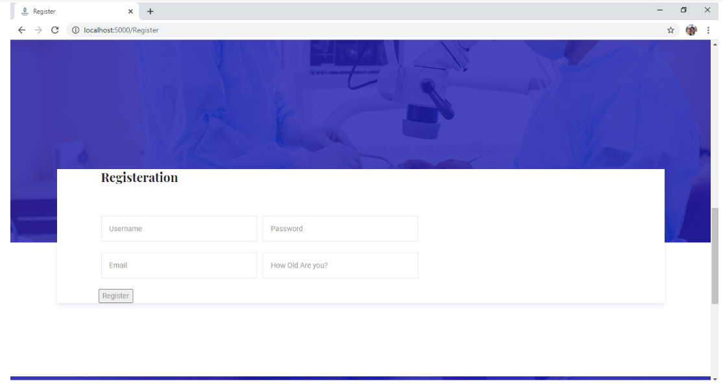
The Registration Page

Slide 9
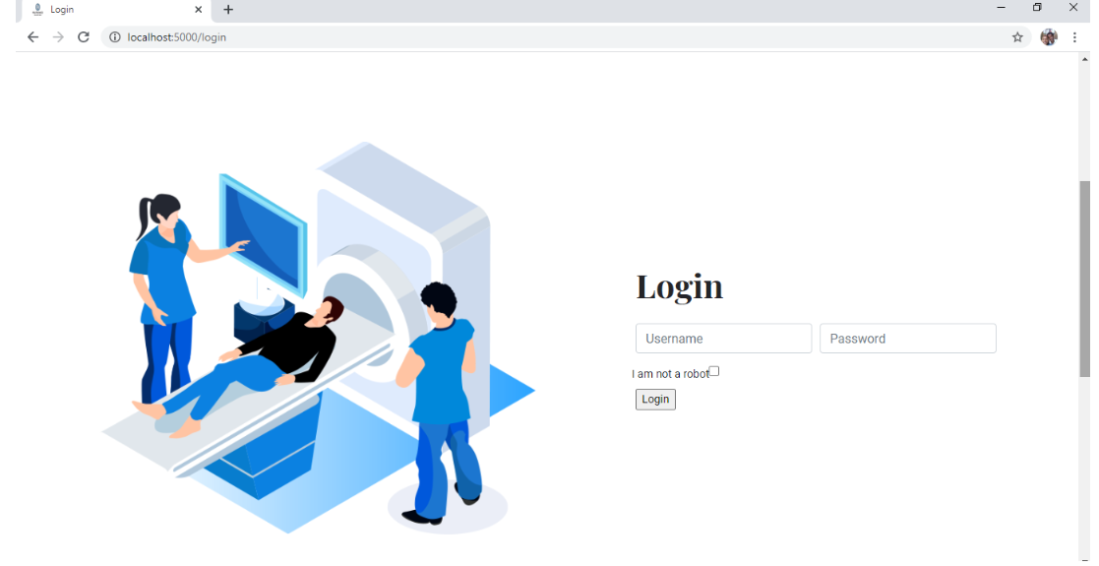
The Login Page

Slide 10
Steps of creating The Web Application:
Code Implementation.

Slide 11
Steps of creating The Web Application:
Test Results’ Report:
Scope
Metrics
Tested Functions
Results

Slide 12
End Of Presentation.
Grazie!

